Slide 1


Effect of Sn dopant on thermoelectric properties of β-FeSi2
Sopheap Sam, Genki Kashikawa, Hiroshi Nakatsugawa
Graduate School of Engineering Science
Yokohama National University, Japan

Slide 2
Outline
Introduction
2. Experiment
3. Result and discussion
  Crystal structure identification
  Resistivity
  Seebeck Coefficient
  Thermal conductivity
  ZT
4. Conclusions

Slide 3
Introduction

Slide 4
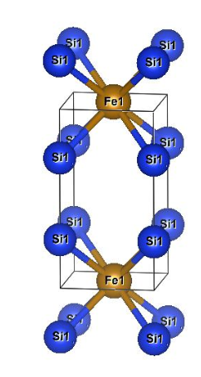
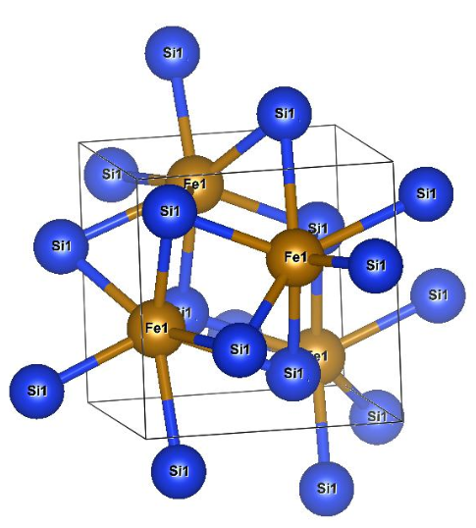
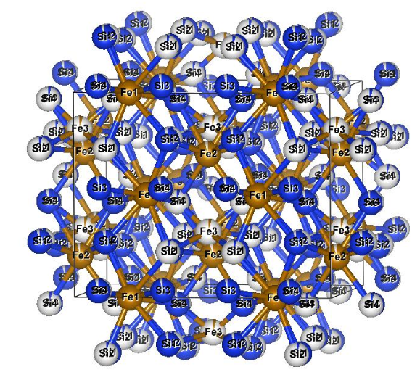
Crystal structure and characteristic of β-FeSi2
Crystal Structure of each phase transition of FeSi2
Orthorhombic β-phase
Tetragonal α-phase
Cubic ε-phase
Why β-FeSi2 for this study?
According to D. Xiaolong et al.,(2020), the β-FeSi2 based material is a promising candidate for thermoelectric (TE) application working at high temperatures up to 900 C due to:
Environmental friendliness
Good thermal stability
Strong oxidation resistance
Low cost

Slide 5
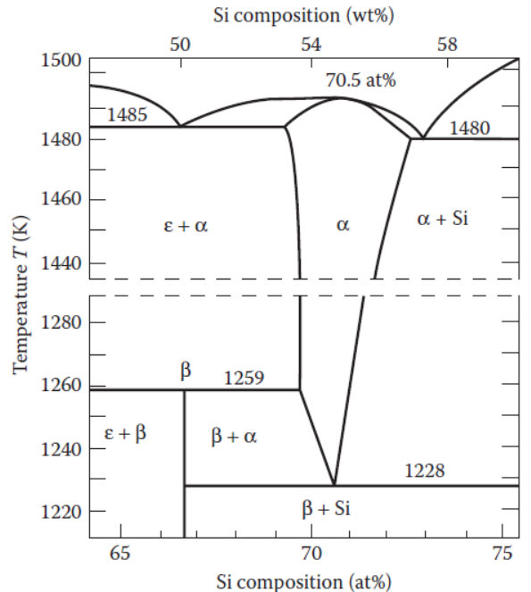
Phase transition diagram of FeSi2
The high temperature [between the eutectic and peritectoid temperatures (1485 and 1259K)] α and ε-phase of FeSi2 is a metal.
The low temperature (below 1259K) β-phase FeSi2 is a semiconductor.
The equilibrium phase diagram for the system Fe–Si by Piton and Fay. α-phase:FeSi2, β-phase:FeSi2, ε-phase:FeSi.

Slide 6
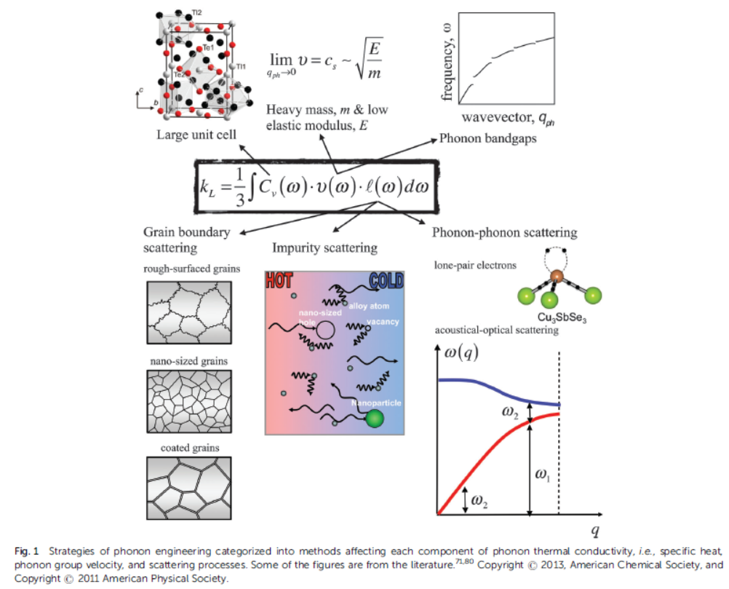
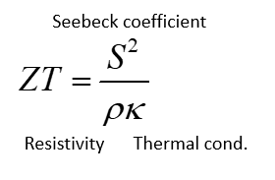

Strategy to improve ZT of β-FeSi2 by Sn-doped
Density of Si: 2.33 g/cm³
Density of Sn: 7.31 g/cm³
Melting point of Si: 1,410 °C
Melting point of Sn: 231.9 °C
Sn has heavier mass (m) than Si.
Sn has low melting point related the low elastic modulus (E) due to weak chemical bonds.
Therefore, thermal conductivity of β-FeSi2 can be reduced by doping Sn on Si sides.

Slide 7
Strategy to improve ZT of β-FeSi2 by Co-doped
Resistivity: The decrease in electrical resistivity can be achieved by the increase in carrier density by valence electron control.
Can be improved by carrier doping with different valence electron elements.

Slide 8
Experimental Method

Slide 9
Experimental method
Fabrication
Measurement
Arc-melting
NC wire cut
Vacuum sealing
Heat treatment 1150C, 3hours
Annealing 840C, 20h
XRD
Thermal conductivity by PEM-2
ZT calculated by above parameters
Resistivity by Resitest 8300 and homemade apparatus
Seebeck coefficient by Resitest 8300 and homemade apparatus

Slide 10
Result and discussion

Slide 11
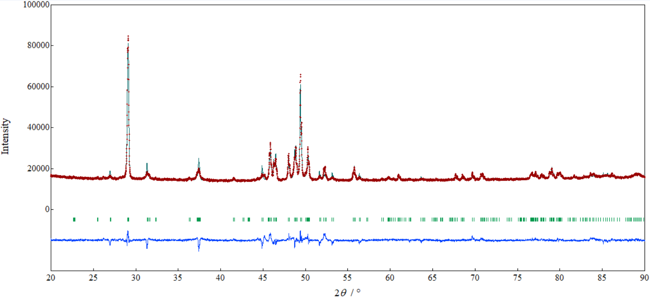
XRD: Crystal Structure identification
β
FeSi₂
(2,2,0)
(4,2,2)
β
β
β
β
β
β
β
β
β
β
By using Rietveld Analysis with the measured data from XRD, all samples were grown in single beta β phase crystal structure with Cmca space group (base-centered orthorhombic) after heat treatment 1150C 3h and annealing 840C 20h.

Slide 12
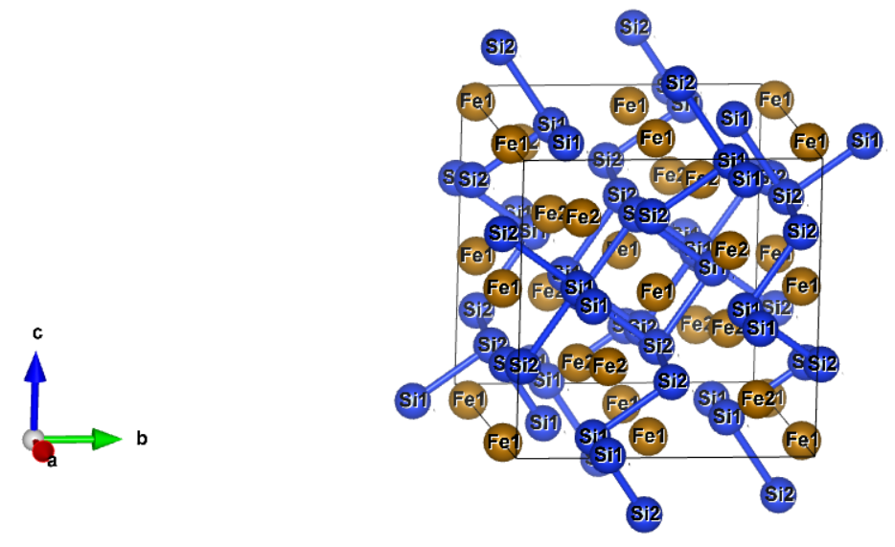
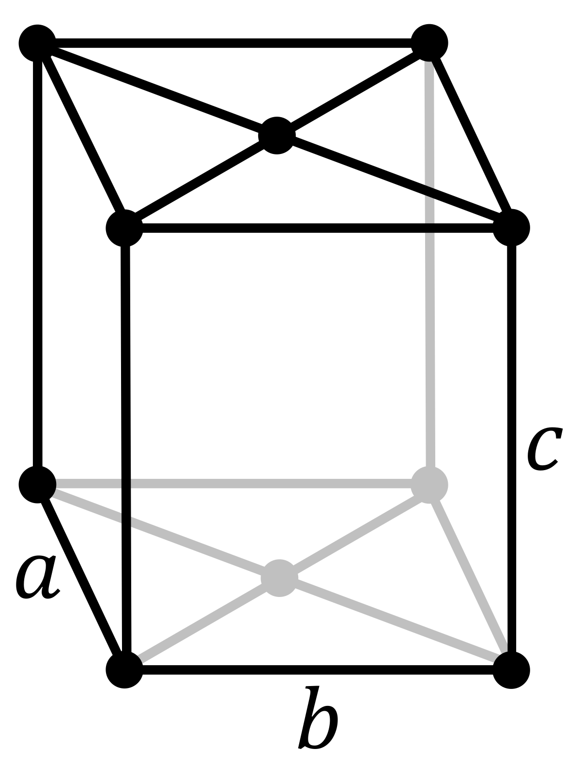
Lattice parameters
Lattice parameters/ Samples | a[Aº] | b[Aº] | c[Aº] | α [º] | β [º] | γ [º] | V[A^{o3}]
FeSi2 | 9.87884(5) | 7.80084(4) | 7.83721(4) | 90 | 90 | 90 | 603.960(6)
FeSi1.995Sn0.005x1.01 | 9.87932(6) | 7.80152(5) | 7.83931(5) | 90 | 90 | 90 | 604.20(7)
Fe0.985Co0.015Si2 | 9.88288(5) | 7.80034(4) | 7.8368(5) | 90 | 90 | 90 | 604.138(6)

Slide 13
Carrier concentration and mobility vs TE properties at room temperature
Sample Name | L [V²/K²] | n_{H} [ 1/cm³ ] | μ_{H}[ cm²/V*s ] | S[μV/K] | ρ[Ωcm] | κ[W/mK] | κ_{e}=LσT | κ_{L}=κ-κ_{e}
FeSi2 | 1.793E-08 | 6.3(9)E+16 | 14(2) | -127.22 | 7.23 | 7.65 | 0.0000744 | 7.65
FeSi1.995Sn0.005x1.01 | 1.749E-08 | 3.4(9)E+16 | 29(7) | -140.00 | 6.67 | 6.77 | 0.0000787 | 6.77
Fe0.995Co0.005xSi2 | 3.014E-08 | 1.0(0)E+19 | 6(5) | -371.33 | 0.232 | 9.71 | 0.0083038 | 9.70
Fe0.985Co0.015Si2 | 2.932E-08 | 1.8(7)E+19 | 9(4) | -299.00 | 0.044 | 7.08 | 0.0201071 | 7.06
Low mobility because of carriers (electrons) are scattered more frequently than the Sn-dope sample.

Slide 14
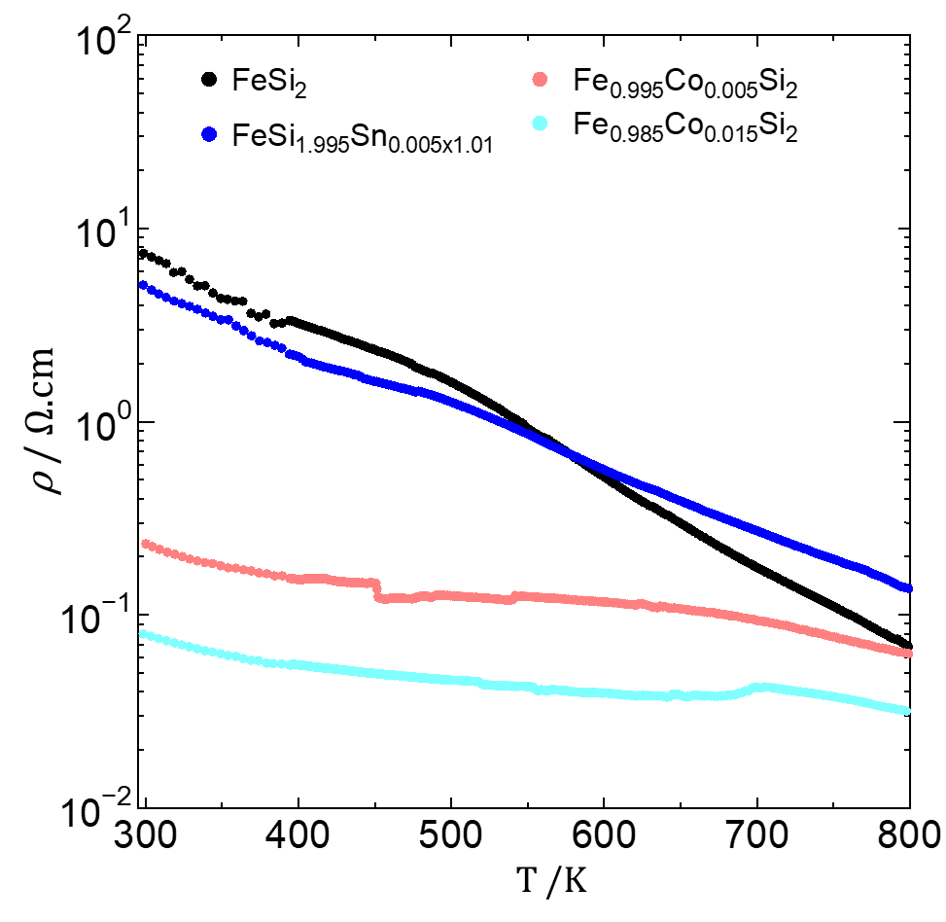
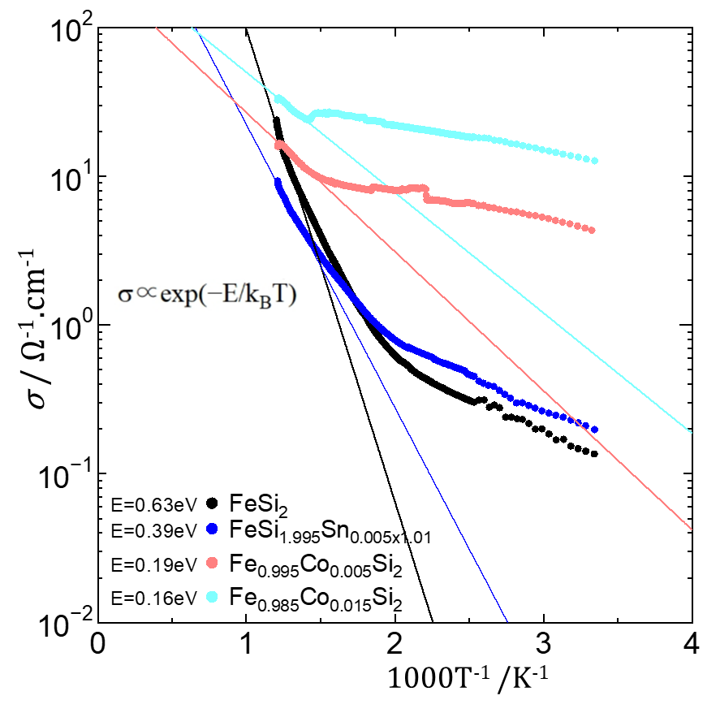
Resistivity and Conductivity
n_{H}=6.3(9)E+16
μ_{H} = 14(2)
n_{H}=3.4(9)E+16
μ_{H}=29(7)
n_{H}=1.0(0)E+19
n_{H}=1.8(7)E+19
At temperature below 500K, the electrical conductivity (σ) of Sn doped sample was higher than standard sample. The activation energy is shafted as shown in straight line.
The σ of Co-doped sample was significantly higher than other samples. It is affected by the increase of carrier concentration because of doping with elements having different valence electrons.

Slide 15
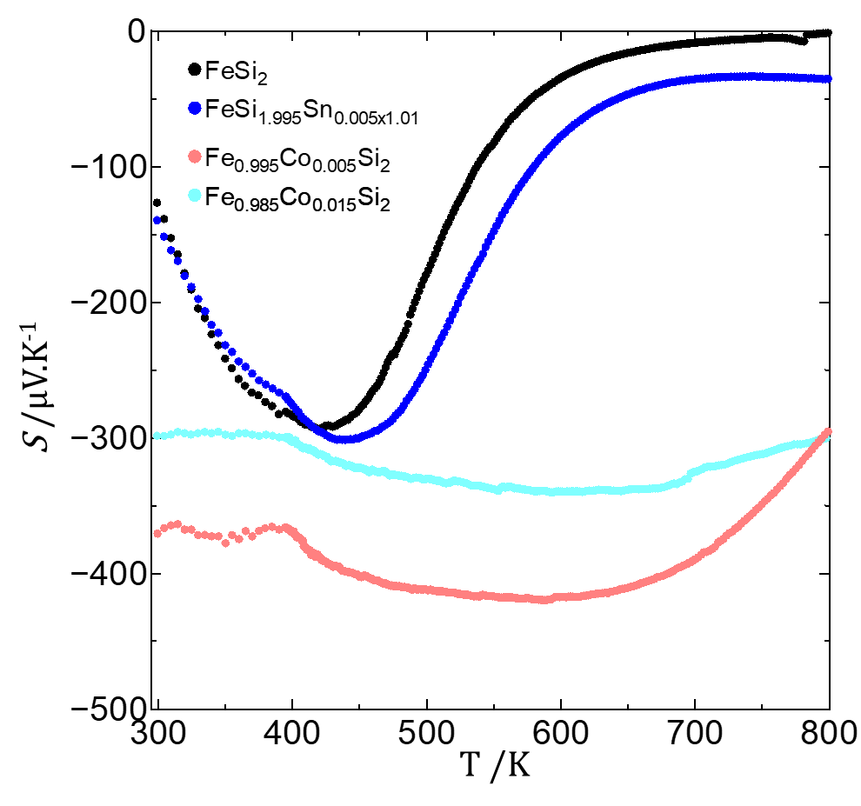
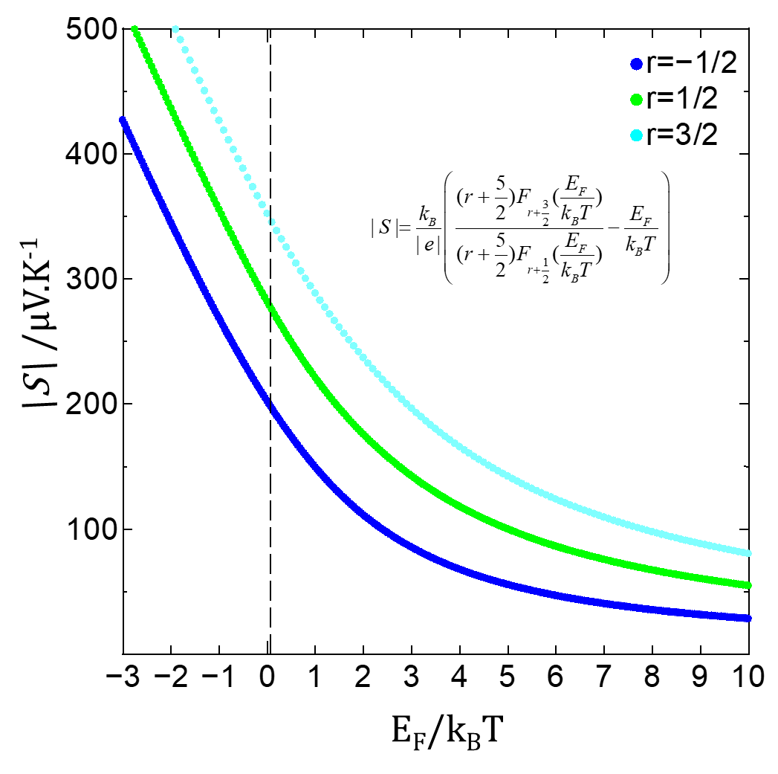
Seebeck coefficient
μ_{H} =9(4)
μ_{H} =6(5)
|S| of Co doped 0.005 sample ≥ 350μV K⁻¹ and approximately stable at all temperature ranges below 700K. The carrier concentrations of this sample is maybe stable below this temperature. Or the electrons of this samples are scattered more frequently than the others.
Co-dope sample is dominated by ionized impurity scattering (r=3/2) rather than acoustic phonon scattering or polar optical phonon scattering.

Slide 16
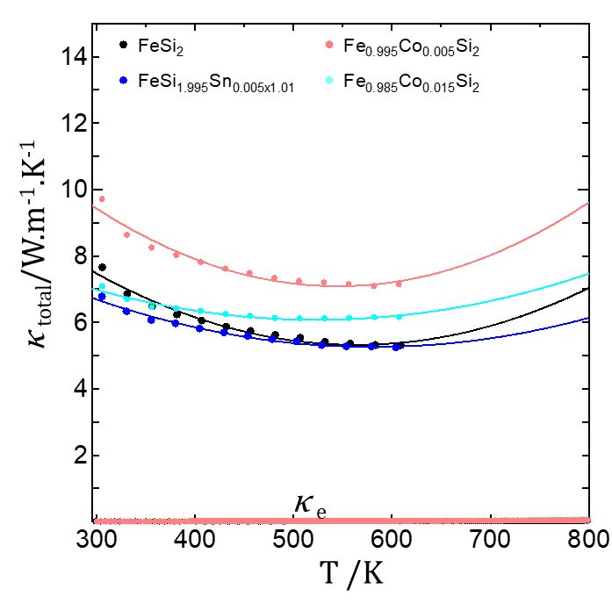
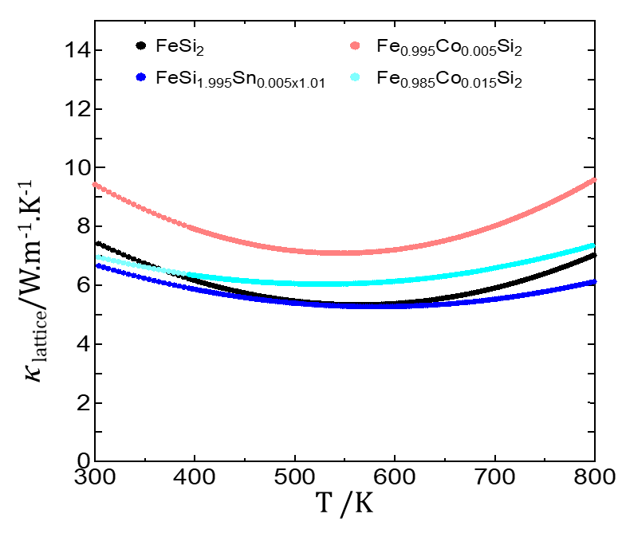
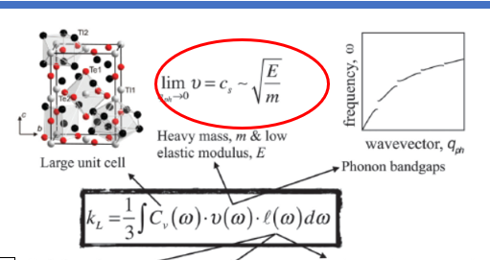
Thermal conductivity
At room temperature, lattice thermal conductivity of Sn doped (x=0.005) was lower than other samples resulting in the significant reduction of total thermal conductivity at various temperature range. This confirms to our strategy because Sn has higher density and elastic modulus (low melting point).

Slide 17
ZT
ZT
T /K
The highest ZT=0.03 was found in Co doped sample at 650K. This enhancement was obtained from the stability of |S| and significant reduction of 𝛒.

Slide 18
Conclusion

Slide 19
Conclusions
The σ of Co-doped sample was significantly higher than Sn doped and standard samples and approximately stable at all temperature ranges. The increase of σ was affected by the increase of carrier concentration.
Doping with Co, |S| ≥ 300μV K⁻¹ and approximately stable at all temperature ranges. It is considered that the carrier scattering is stable by ionized scattering process.
Lattice thermal conductivity of Sn doped (x=0.005) was lower than other samples resulting in the significant reduction of total thermal conductivity at various temperature range.
The highest ZT=0.03 was found in Co doped sample at 650K. This enhancement was obtained from the stability of |S| and significant reduction of 𝛒.

Slide 20
Thank you for your attentions!
For further clarification, please contact: sam-sopheap-fh@ynu.jp.

